Slide 1
TK2100: Informasjonssikkerhet Lesson 08: HTTP and Web
Dr. Andrea Arcuri
Westerdals Oslo ACT
University of Luxembourg

Slide 2
Goals
Understand how Browsers communicate with Web Servers using HTTP/S
Understand how Web Applications are architectured
Base knowledge of how to do AJAX calls in JavaScript

Slide 3
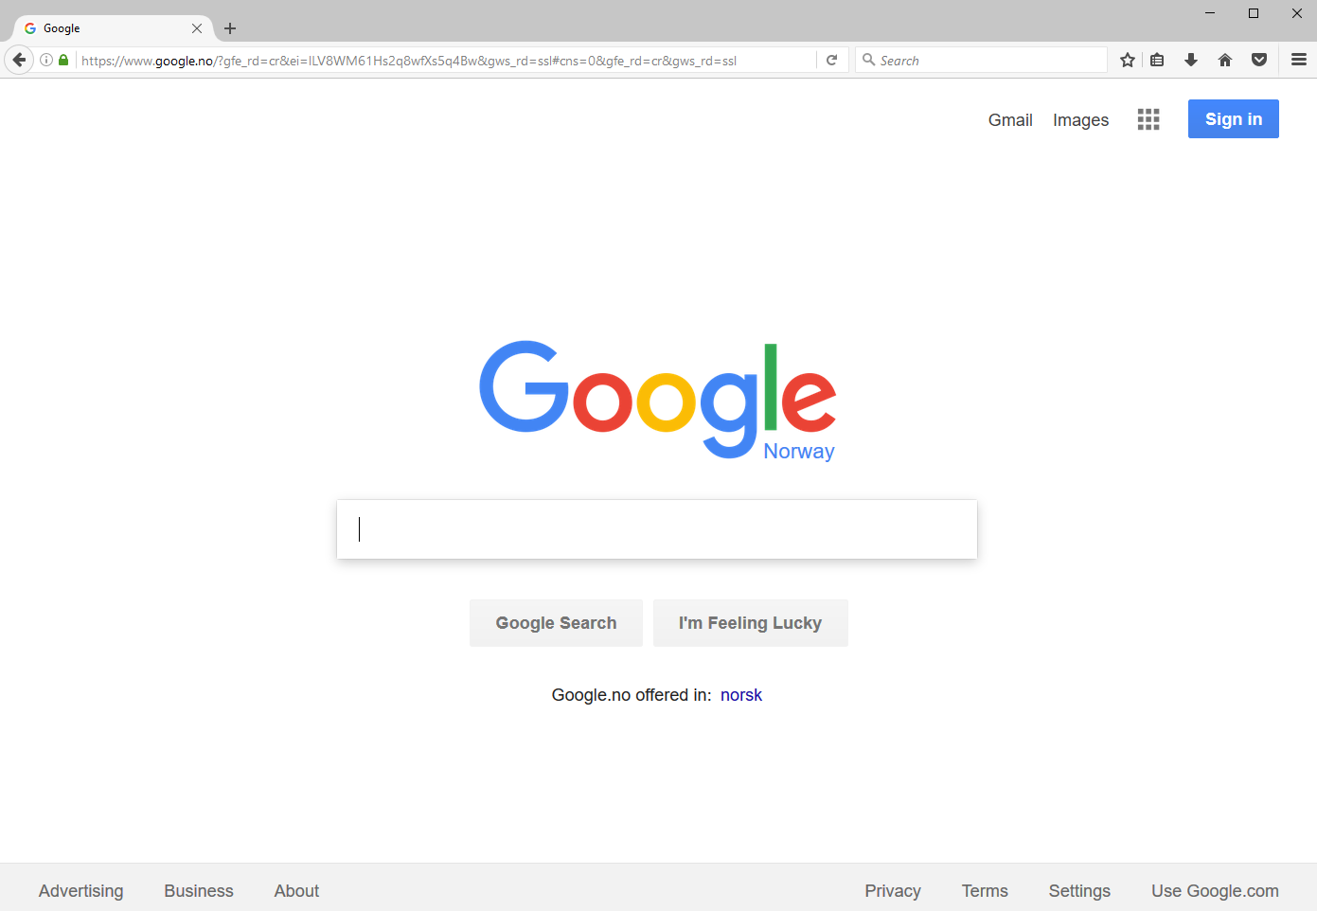

Slide 4
World Wide Web (WWW)
Invented by Tim Berners-Lee in 1989, at CERN, Switzerland
I was in high school when it was first available…
WWW is a set of documents/resources distributed among different machines
Resources/documents are identified with a Uniform Resource Locator (URL)
Resources are accessed/downloaded over the internet, typically HTTP over TCP
A web page is a resource written in HTML format
Browsers are tools used to download/visualize HTML pages, and enable the following of links

Slide 5
Send a HTTP request, and get back a HTML page which will be visualized in the browser

Slide 6
(Briefly) HTTP
Hypertext Transfer Protocol (HTTP)
When browser connects to server, will be a TCP connection on a given port (usually 80 and 443)
HTTP represents how the messages are structured
eg, retrieve a certain file
eg, send data, like username/password for login
HTTPS: the S stands for Security. Protocol in which HTTP is encrypted

Slide 7
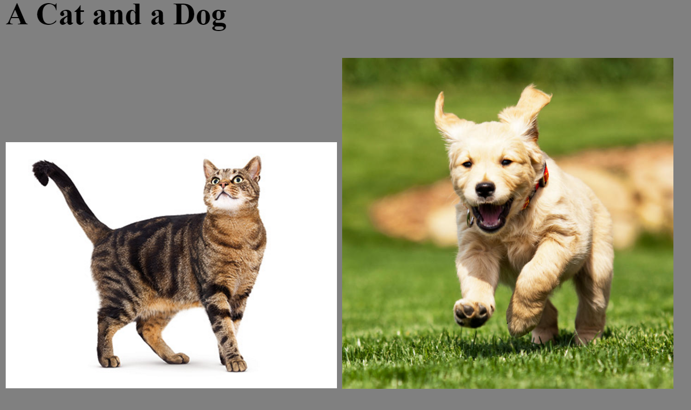

Slide 8
<HTML>
<HEAD>
<TITLE>Example</TITLE>
</HEAD>
<BODY BGCOLOR="gray">
<h2> A Cat and a Dog </h2>
<DIV>
<IMG SRC="figs/cat.jpg" style="width:256px">
<IMG SRC="figs/dog.jpg" style="width:256px">
</DIV>
</BODY>
</HTML>

Slide 9
Links to other files
To display the page in the previous slide, after a GET of the index.html page, the browser will do 2 further HTTP GET requests
Those further 2 requests could be done in parallel on two different TCP connections

Slide 10
Many browsers…
Chrome (from Google)
Firefox (from Mozilla)
Edge (from Microsoft)
Mainly used to download Chrome/Firefox
Safari (from Apple)
Mainly used to download Chrome/Firefox, but OK on iPhone
Opera
… and others: PaleMoon, SeaMonkey, etc.

Slide 11
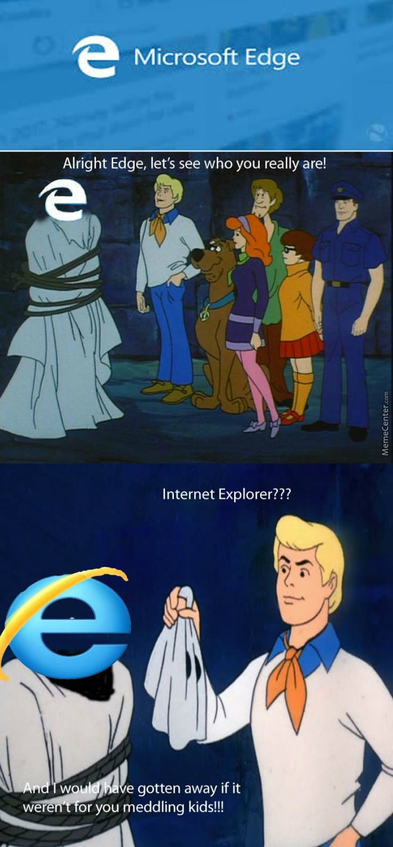

Slide 12
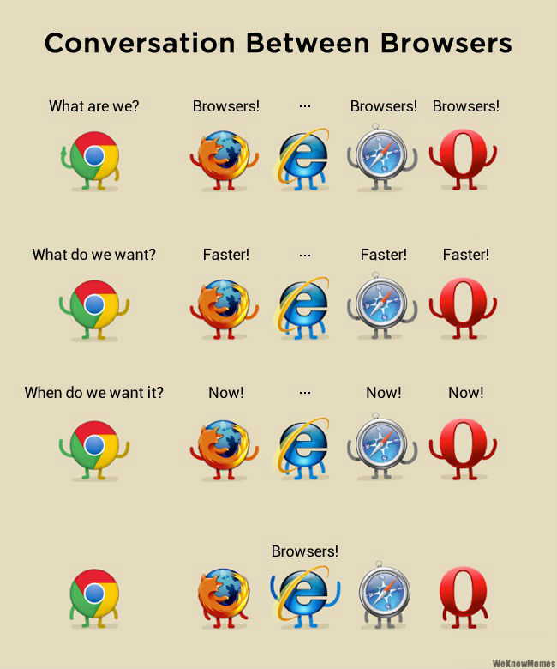

Slide 13
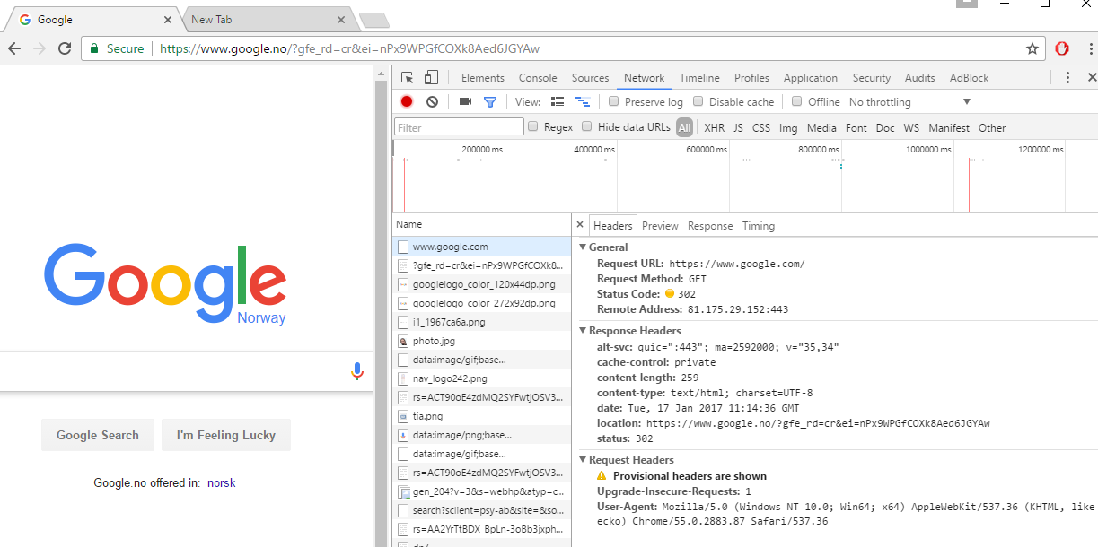
VERY IMPORTANT: Chrome -> More Tools -> Developer tools

Slide 14
Defaults
When nothing specified, browsers do default to known ports for the given protocol
Default protocol is HTTP, and default resource is the root “/”
So typing www.google.com is equivalent to http://www.google.com:80/
Typing https://www.google.com is equivalent to https://www.google.com:443/
Note: the page you request might not be the one you will get, as you could get a HTTP 3xx redirection

Slide 15
URL (Uniform Resource Locator)
Reference to a web resource and how to retrieve it
scheme:[//[user:password@]host[:port]][/]path[?query][#fragment]
https://en.wikipedia.org:443/wiki/Uniform_Resource_Locator#Syntax
scheme
port
fragmet
host
path

Slide 16
Cont.
Scheme: how to access the resource
http, https, file, ftp, etc.
Host: the name of the server, or directly its numeric IP address
Port: the listening port you will connect to on the remote server
Path: identifies the resource, usually in a hierarchical format
Eg, /a/b/c
Query: starting with “?”, list of <key>=<value> properties, separated by “&”
eg https://github.com/search?q=java&type=Repositories&ref=searchresults
Fragment: identifier of further resource, usually inside the main you requested
Eg, a section inside an HTML page

Slide 17
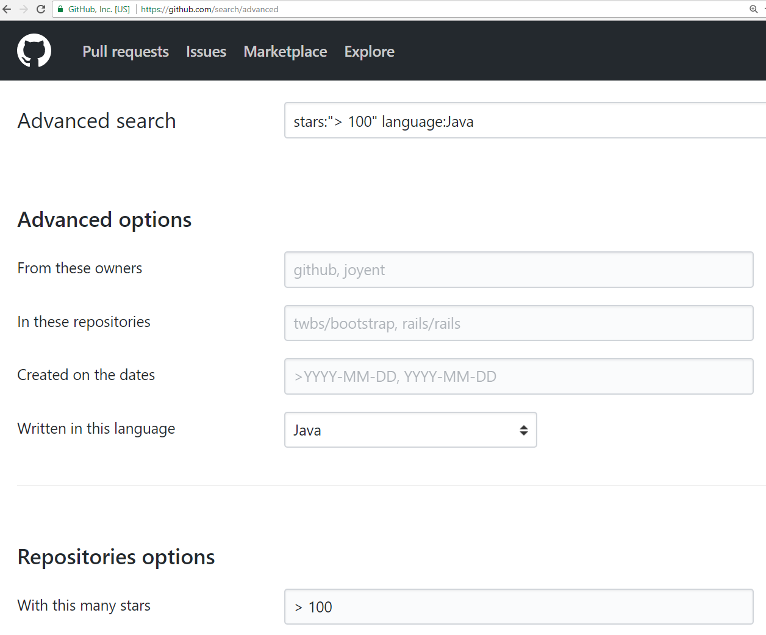
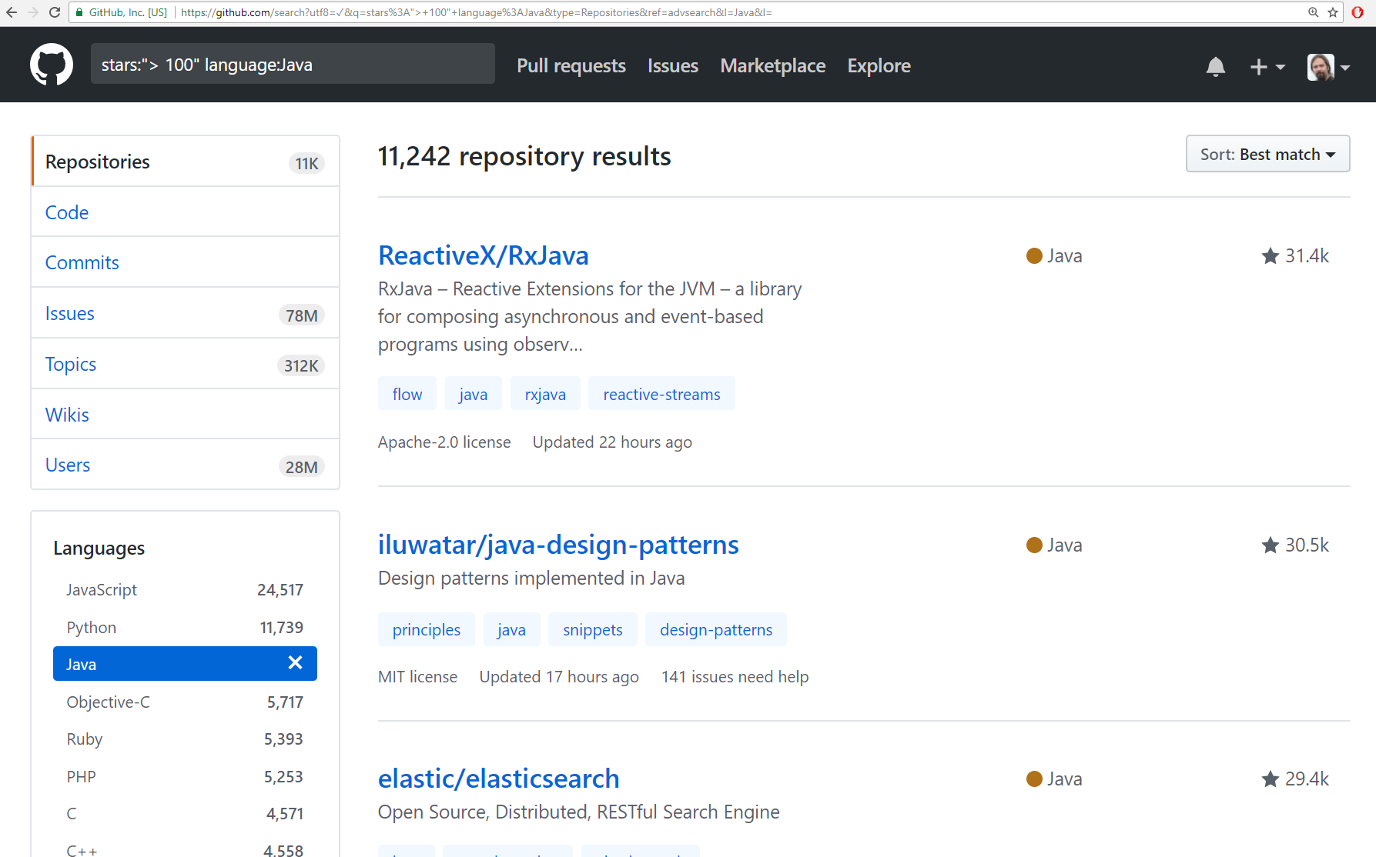
https://github.com/search?utf8=%E2%9C%93&q=stars%3A%22%3E+100%22+language%3AJava&type=Repositories&ref=advsearch&l=Java&l=
The asked page/resource is /search, where it is retrieved in different ways based on the list of query “?” parameters

Slide 18
URI (Uniform Resource Identifier)
String of characters used to identify a resource
A URL is a URI:
Exactly same format
In URL, the resource is typically located on a network
Given a URL, you should be able to access the resource, which is not necessarily true for URI
The distinction between URL and URI is conceptually very thin
Most people use the two terms interchangeably

Slide 19
HTTP

Slide 20
HTTP History
Started at CERN in 1989
1995: version 0.9
1996: version 1.1
1999: “updates” to 1.1
2014: more “updates” to 1.1
2015: version 2.0

Slide 21
Http Versioning: What a Mess!!!
HTTP is one the worst examples of versioning done wrong
Changing specs and semantics over 18 years, but still keeping the same version number 1.1!!!
Why? To support the largest number of browsers, even very old ones
Not many people realized there was an update in 2014… you might still find quite a few libraries/tools that wrongly use the 1999 version

Slide 22
RFC (Request for Comments)
Technically, a RFC is not a “standard” yet, but it is de-facto in practice
RFC 7230, HTTP/1.1: Message Syntax and Routing
RFC 7231, HTTP/1.1: Semantics and Content
RFC 7232, HTTP/1.1: Conditional Requests
RFC 7233, HTTP/1.1: Range Requests
RFC 7234, HTTP/1.1: Caching
RFC 7235, HTTP/1.1: Authentication
RFC 7540, HTTP/2
Etc.
For the ones of you that will work as frontend/backend developers, recommended to study these documents in details

Slide 23
HTTP 1.1 vs 2
v2 is quite recent (2015), and still not so common
Unless otherwise stated, we ll just deal with v1.1
From user’s perspective, v2 is like v1.1
Same methods/verbs, just better optimization / performance improvement
More like adding functionalities, not replacing it
Main visible difference: v1.1 is “text” based, whereas v2 has its own byte format (less space, but more difficult to read/parse for humans)

Slide 24
HTTP Messages: 3 Main Parts
First line specifying the action you want to do, eg GET a specific resource
Set of headers to provide extra meta-info
eg in which format you want the response: JSON? Plain Text? XML?
In which language? Norwegian? English?
(Optional) Body: can be anything.
Request: usually to provide user data, eg, login/password in a submitted form
Response: the actual resource that is retrieved, eg a HTML page

Slide 25
First line
<METOD> <RESOURCE> <PROTOCOL> \r\n
Ex.: GET / HTTP/1.1
<method> GET
<resource> /
<protocol> HTTP/1.1
A resource can be anything
html, jpeg, json, xml, pdf, etc.
A resource is identified by its path
Recall URI, and such path is same as file-system on Mac/Linux, where “/” is the root

Slide 26
Different kinds of Methods
GET: to retrieve a resource
POST: to send data (in the HTTP body), and/or create a resource
PUT: to replace an existing resource with a new one
PATCH: to do a partial update on an existing resource
DELETE: to delete a resource
HEAD: like a GET, but only return headers, not the resource data
OPTIONS: to check what methods are available on a resource
TRACE: for debugging
CONNECT: tunneling connection through proxy

Slide 27
Method Semantics
Each of the methods has a clear semantics
Eg GET does retrieve a resource, whereas DELETE should delete it
But how the application server does handle them is completely up to it
Eg, an application server could delete a resource when a GET is executed

Slide 28
Verbs should not be in paths
Given a resource “/x.html”
Wrong: GET on “www.foo.org/x.html/delete” to delete “x.html”
Here the resource would be “/x.html/delete”
Also wrong to use query, eg “www.foo.org/x.html?method=delete”
Paths should represent/identify resources, and NOT actions on those

Slide 29
Idempotent Methods
RFC 7231: “A request method is considered idempotent if the intended effect on the server of multiple identical requests with that method is the same as the effect for a single such request...
… if a client sends a … request and the underlying connection is closed before any response is received, then the client can establish a new connection and retry the idempotent request.”

Slide 30


Which methods are idempotent?
GET
POST
DELETE
PUT
PATCH
HEAD

Slide 31
Headers
Extra meta-information, besides Method/Resource
Pairs <key>:<value>
For example:
In which format am I expecting the resource? HTML? JSON?
In which language do I want it?
Who am I? (important for user authentication)
Should the TCP connection be kept alive, or should it be closed after this HTTP request?
Etc.

Slide 32
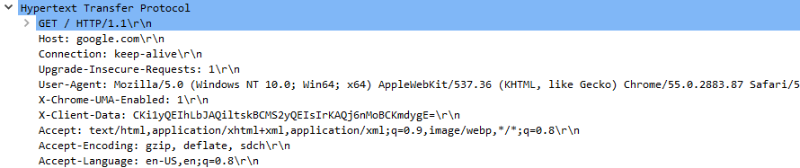
Request for www.google.com
Recall, you can use WireShark or Chrome Developer Tools

Slide 33
“Host” Header
For example “Host: google.com\r\n”
REQUIRED header (it has to be there)
A server running on an IP x.y.z.w might serve for different host names, eg foo.com, foo.org, foo.no, bar.com, etc., all pointing to the same IP x.y.z.w
Host names are translated to IP addresses (recall DNS)
A TCP connection (used for HTTP) knows about IP, not host names
Without the “Host” header, server would not know for which host the request is for
How to differentiate a request for “www.foo.org:80/index.html” from “www.bar.no:80/index.html” running on same server?
Application-level routing mechanism

Slide 34
“Connection” Header
To send an HTTP message to www.foo.org:80, I need a TCP connection toward foo.org on port 80
What to do after a message is sent and got response?
Should the server keep the connection open for further requests from the same client?
Opening a TCP connection is expensive, so should be re-used as much as possible
But keeping alive a non-needed TCP connection is expensive as well
Solution: “Connection: keep-alive” and “Connection: close”

Slide 35
“upgrade-insecure-request” header
When doing a non-secure request over HTTP, header used to tell the server that, if they support HTTPS, then switch to it
HTTPS is encrypted
Note: this is independent from authentication/authorization of a user
Eg many websites are moving to HTTPS even for displaying resources that do not need a registered user (eg, searches on Google)
Why???
Encryption is not so expensive / time consuming any more
Avoid proxies / internet providers to modify the returned responses, eg inject their own ads in the retrieved HTML pages

Slide 36
“User-Agent” Header
Tells information about the client, for example browser type/version, OS, etc.
The server might reply differently based on the client capabilities
This was a huge problem with Internet Explorer
You will see that most browsers identify themselves as “Mozilla/5.0”
Ie, they claim to be compatible with Mozilla version 5.0
Mozilla Browser is the old name for FireFox Browser
Why??? Some servers, in the old days, gave degraded functionalities/pages if agent was not compatible with “Mozilla/5.0”
Nowadays? Might use “User-Agent” to check if client is a mobile, and give different pages from the ones served to a PC

Slide 37
“Accept” Header
Specify in which format we expect the response
HTML? Plain text? JSON? XML? JPEG? Etc.
Might specify more than one, where parameter “q in [0,1]” specify preference
Comma “,” separated list, where each element can have properties with “;”, for example: text/html,application/xhtml+xml,application/xml;q=0.9,image/webp,*/*;q=0.8
text/html, application/xhtml+xml and image/webp are the main preferences (default q=1)
the “+xml” means that the specified format (xhtml) is a syntactically valid xml
application/xml;q=0.9 is second preference (0.9 < 1)
*/* means “any”, and last preference (0.8)

Slide 38
“Accept-Encoding” Header
To save bandwidth, a resource could be compressed (eg zipped) when sent by the server
But need to tell the server which kind of algorithm the client (browser) can support, eg be able to decode/unzip
Accept-Encoding: gzip, deflate, sdch\r\n

Slide 39
“Accept-Language” Header
A web application might support its pages in different languages
When sending a HTTP request, might use header to specify a preference for the language
Accept-Language: en-US,en;q=0.8\r\n
Main preference “en-US” (default q=1)
Second preference “en” (0.8)
If server does not support a language, might just return default one
Recall: those headers just express a “preference” of the client
Note: server might just ignore that header, and give you language based on your IP geolocation (very annoying when travelling…)

Slide 40
“Cookie” Header
Likely the most important header
HTTP is stateless, so cannot know if 2 requests come from same user
User can send an identifying token in the cookie value, given by server in the first response
Eg, “cookie: sfjdfig4397217846tyjewfs”
There is a lot privacy concern regarding cookies, eg can track user behaviors even if s/he does not register and agree
Depending on the country, there are laws regulating how cookies can be used (eg, have to ask permission to the user)
We will go into its details later in the course

Slide 41
Custom Headers
There is a pre-defined, standardized set of HTTP headers
Many more than what shown in these slides…
But you can use any custom header if you want… but clients/servers need to know how to interpret them
“Usually” (ie convention) custom headers would start with a “x-”, to clearly distinguish them from the standard ones
Eg, “x-Chrome-UMA-enabled”

Slide 42
HTTP Body
After last header, there must be an empty line
Any data after that, if any, would be part of the payload, ie HTTP body
Request: needed for POST, PUT and PATCH
Response: needed for GET (also the other methods “might” have body, but HEAD)

Slide 43

http://www.rd.com/wp-content/uploads/sites/2/2016/04/01-cat-wants-to-tell-you-laptop.jpg

Slide 44
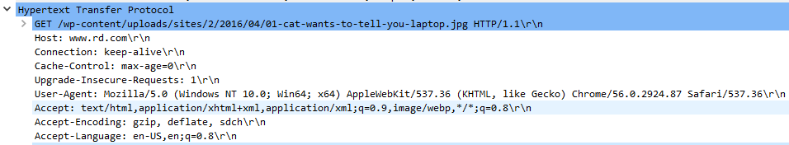
GET with no body
Have a look at the “Accept” header… there is no “jpg” there, why?

Slide 45
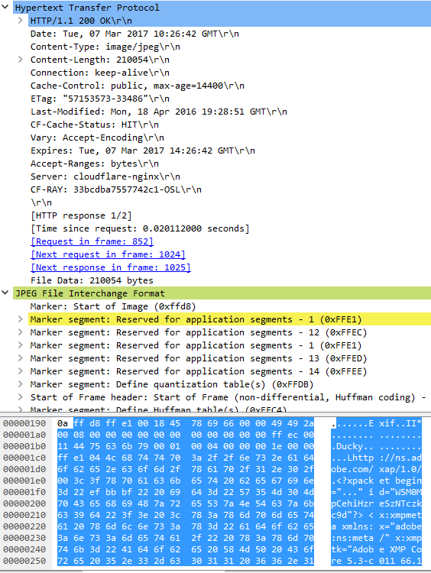
In this case, payload is in JPEG format
“Content-type” header:
need to specify the format, eg JPEG. Note this is necessary because what requested by user (“Accept”) might be a list, and also server might return something different
“Content-length” header:
Essential, otherwise HTTP parser cannot know when payload is finished
Cache handling: headers like “Cache-Control”, “ETag”, “Last-Modified”, etc.
If visiting page for second time, no need to re-download image if hasn’t changed

Slide 46
HTTP Response
Same kind of headers and body as HTTP request
Only first line does differ
<PROTOCOL> <STATUS> <DESCRIPTION>
Eg, “HTTP/1.1 200 OK”
Note: only 1 space “ ” between the tags, I added extras just for readability
When making a request, a lot of things could happen on server, and the “status” is used to say what happened

Slide 47
HTTP Status Codes
3 digit number, divided into “families”
1xx: informational, interim response
2xx: success
3xx: redirection
4xx: user error
5xx: server error

Slide 48
2xx Success
200: OK
201: resource created
202: accepted, but not completed (eg, background operation)
204: no content (eg, as result of PUT or DELETE)

Slide 49
3xx Redirection
Note: the semantics of these codes is a “mess”, being changing with different “updates” of HTTP 1.1… and being left in an inconsistent state
301 permanent redirection
If X redirects to Y, then client will never ask for X again, and go straight for Y
302 temporary redirection
“May” change verb, eg from POST to GET
307 temporary redirection, but same verb
Eg, a POST stays a POST
“Location” header: URI of where we should redirect

Slide 50
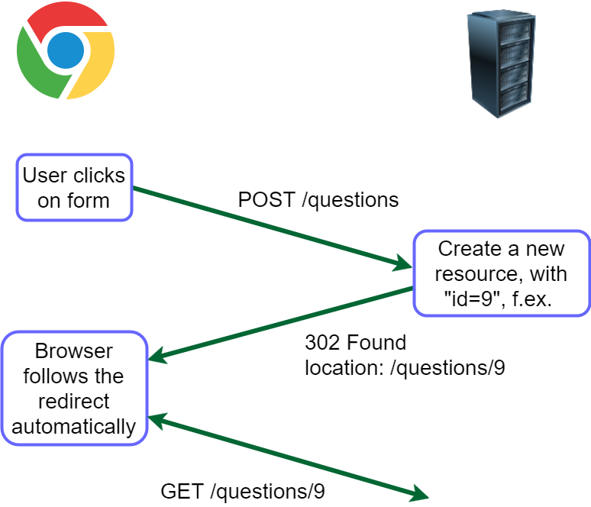

Slide 51
4xx User Error
400: bad request (generic error code)
401: unauthorized (user not authenticated)
403: forbidden (authenticated but lacking authorization, or not accessible regardless of auth)
Note: RFC 7231/7235 are rather ambiguous/confusing when it comes to define authentication/authorization, and differences between 401 and 403
404: not found (likely the most famous HTTP status code)
405: method not allowed (eg doing DELETE on a read-only resource)
415: unsupported media type (eg sending XML to JSON-only server)

Slide 52
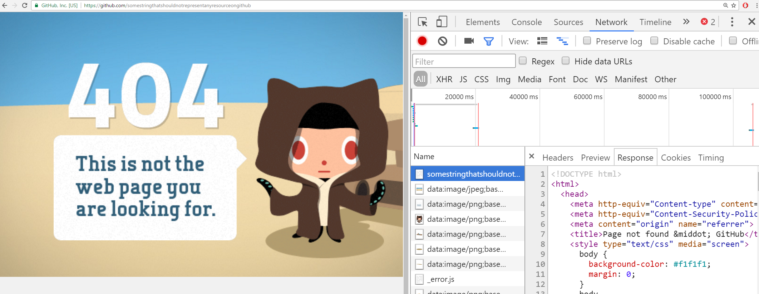
Even if error (eg 404), response can have a body, eg an HTML page to display

Slide 53
5xx Server Error
500: Internal Server Error
Often, a bug, eg an exception in the business logic (like a NPE), that propagates to the application server will be handled with a 500 response
Note: if whole application server does crash, then you get no response…
Required external services have problems, eg database connection failed
503: Service Unavailable
Eg, overloaded of requests, or scheduled downtime for maintenance

Slide 54
HTTPS (HTTP Secure)
Encrypted version of HTTP, using Transport Layer Security (TLS)
Usually on port 443 instead of 80
URIs are the same as in HTTP (just the “scheme” does change)
Note, the whole HTTP messages are encrypted, but still using TCP
this means it is still possible to find out the IP address and port of remote server, although cannot decipher the actual sent messages
this issue can be avoided by going through proxy networks like TOR , or any VPN provider (but this latter would know what you visit)
More on this later in the course

Slide 55
Web Applications

Slide 56
HTTP Server Application
A program that opens a TCP port (eg, 80 or 443) and listens on incoming requests
For each request, will send a HTTP response with the given requested resource
The “resource” might be an existing file on disk (e.g., an HTML page or JPEG image), or created on the fly (eg based on content in database)
In the “old days”, a “web application” was just a set of static files accessible over HTTP

Slide 57
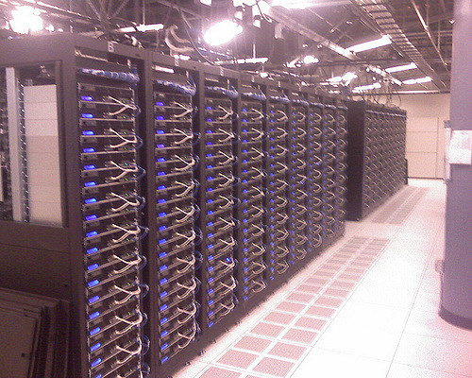
Old Days Server
/where/installed/
/index.html
/figs/cat.jpeg
/figs/dog.jpeg
Application server running on port 80, providing files from the folder “/where/installed”
If browser asks for “www.foo.org/index.html”, the server will check if a file called “index.html” is under the folder “/where/installed”, and return it as Body of the HTTP response

Slide 58
Cont.
When asked for “www.foo.org/index.html”, the browser will:
Resolve the IP address of www.foo.org with DNS
Establish a TCP connection toward <IP address>:80
Do a HTTP request with command: “GET /index.html HTTP/1.1”
Here the “index.html” is the requested resource
If asking for “www.foo.org/figs/cat.jpeg”, the request command will be “GET /figs/cat.jpeg HTTP/1.1”
What after the <IP address>:<port> is the so called “path” that identifies the resource on the server
Note: the client browser has no clue of where the files are actually stored on the server, ie the “/where/installed” folder

Slide 59
Dynamic Pages
Static, pre-defined HTML pages are not enough for modern applications
You might want to base the HTML pages on data from database or dynamic content
Web forum
Shopping cart
Live chats
Etc.
HTML pages will need to be created on the fly at each HTTP request
Browser will still just see a HTML file: no clue if automatically generated

Slide 61
Server-Side HTML Rendering
The whole HTML page is created on the server in one go
HTML templates
Files that mix together HTML data and instructions/code on how to create the dynamic parts
Many different template technologies, even within the same language
eg, PHP, JSP/JSF for Java, Ruby on Rails, etc.

Slide 62
HTML Triggering Actions
<a href=”target” />
Do a HTTP GET on the given resource specified by the “target” URI
Note: <a> does have an attribute “type”, but many browsers just ignore it… yep, welcome to the beautiful world of internet standards!!!
<form><input /></form>
Will do a GET or a POST (based on method attribute), with data from the input fields
How can I do something like “DELETE /questions/5” ???
In HTML, you simply CANNOT
You need to use JavaScript…

Slide 63
AJAX (Asynchronous JavaScript and XML)
Executing JS on the client browser opens the door to many possibilities
JS can retrieve new data from the server in the background, and update the current webpage without the need for the user to reload it completely
Chats
News (eg, refreshed every hour)
Etc.
JS can run in background, and do AJAX calls every X seconds to server to retrieve data in XML/JSON format, and update DOM accordingly

Slide 65
WebSocket
Limitation of AJAX is that client has to make the request for data
Asking at time intervals (eg every 10s) is inefficient:
Many requests, often even if new data is not available
If new data is available, cannot get it immediately, and have to wait till next scheduled AJAX call
WebSocket is a protocol working on TCP to allow full-duplex communication between client and server
Server can “push” new data even if client did not ask for it
A relatively recent protocol… first version in Chrome in 2009

Slide 66
Front-End Development
Front-end development is becoming more complex
Can be 10s or 100s of thousands of lines of JS
Making good GUIs requires special skills, eg in interaction design
In large organizations, not strange to have separated teams for front-end and back-end development
In such cases, using “template” technologies might not be the best option
Front-end developers might be HTML/CSS/JS specialists that might not know about the specific language(s) chosen for the backend
When your pages depend on running the backend, it is more difficult to prototype the GUI

Slide 67
Possible Solution
Have a complete separation between frontend and backend
Frontend: only “static” files like HTML/CSS/JavaScript
No template language
Backend: provide just data in JSON format, and the client JS will update the DOM from the HTML static files
Ie, client-side rendering
Data can be read via AJAX when HTML page is loaded in browser
How to provide JSON data? RESTful Web Services

Slide 68
REST (Representational State Transfer)
Not a protocol, but rather an architectural style
Used to define how web resources should be structured and accessed
Based on the HTTP protocol
Server will answer to different URL requests, where the path represents the data to return in an hierarchical format, eg
/menus , return all menus
/menus/today , return the menu of today
/menus/today/dishes, return all the dishes in today’s menu
Data can be returned in different formats, but in most cases it is in JSON (JavaScript Object Notation), as client browser JS can directly use it without the need to unmarshal it

Slide 69
JavaScript + REST
More and more companies are moving to this approach to develop web applications instead of server-side templates
Different RESTful services can be written in different languages, serving the same page
Java, Scala, C#, etc.
RESTful can also serve other GUIs, eg mobile apps
Frontend can be tested/prototyped without a running backend server (can just stub out the JSON responses with static files)
No silver bullet: client-side rendering puts more strain on the client, which can become an issue on mobile web browsers

Slide 70



HTTP Server, only
static resources:
HTML/CSS/JS/img/etc
Server will have static resources and dynamic ones
Provided by same server, or different ones behind a gateway
Files
JS modifying HTML pages based on JSON data
HTTP Server,
dynamic REST API,
business logic
JSON

Slide 71
Web Security

Slide 72
Overview
In this class, we will not go into the details of web security
Need to understand how web works before you can “hack” it
Brief overview of topics will see in the next following classes

Slide 73
Cross-Site Request Forgery (CSRF)
We will see how authentication is done in web applications
Once user is authenticated on site A, a CSRF attack is done when visiting a malicious site B
malicious B has code to do operations (ie HTTP calls) on A
eg transfer money to attacker if A is bank application, and when user visits B while logged in on A
can trick user to visit B via social engineering

Slide 74
Cross-Site Scripting (XSS)
NEVER TRUST USER INPUTS!!!
Problem when HTML is based on user inputs
eg, display message in a chat/forum
eg, show back user’s “query” when doing a search query on a site
If data is not sanitized, user can inject messages containing HTML tags and JS code that will be executed when page is updated
e.g., replace whole web page with a Jolly Roger (or any other image)…
Sanitization: replace/delete characters that can alter the context in which the input is used
eg “<” and “>” in HTML/XML documents

Slide 75
SQL Injection
As for XSS, NEVER TRUST USER INPUTS!!!
If SQL queries on database are based on user inputs, if not sanitized, can trick backend to execute arbitrary SQL queries
Can leak info from database!!!
major issues for passwords and credit card numbers
we will see how to protect passwords even in the case of successful SQL Injection attacks
In some (embarrassing) cases, can login without passwords…

Slide 76
JSON and AJAX

Slide 77
JavaScript Object Notation (JSON)
Lightweight data-interchange format
Currently JSON most used format in web communications
in the past XML was more common, especially with SOAP web services
Can be directly used by JavaScript (eg when running in browser) as an object

Slide 78
Two Main Structures
Objects {}, as collection of unordered pairs name-value
Eg: {“username”: “foo”, “age”:18, “hobbies”:{} }
3 fields: username, age and hobbies
Name of fields are in “” quotes
Types can be primitives (eg 18), strings (eg “foo”), objects (eg empty {}), etc.
Operator “:” for assignment
Ordered arrays [], where each element separated by “,”
Eg: [12, {“foo”:4}, 15]
note: type of elements in array can be different, eg numbers and objects

Slide 79
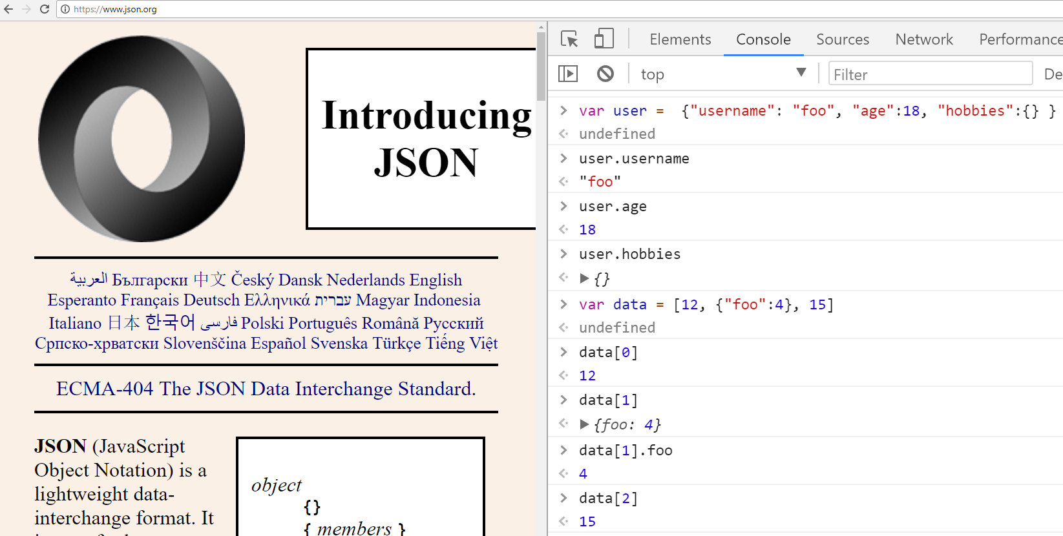

Slide 80
AJAX (Asynchronous JavaScript and XML)
someNameForAFunction = function(){ var xmlhttp = new XMLHttpRequest(); xmlhttp.onreadystatechange = function() { if (xmlhttp.readyState === XMLHttpRequest.DONE) { if (xmlhttp.status === 200) { // do something if call was successful
} else { alert('something went wrong'); } } }; xmlhttp.open("GET", "http://localhost/someURL", true); xmlhttp.send(); };

Slide 81
The name XMLHttpRequest is only for historical reasons, from a time in which XML was the common exchange format instead of JSON
someNameForAFunction = function(){ var xmlhttp = new XMLHttpRequest(); xmlhttp.onreadystatechange = function() { if (xmlhttp.readyState === XMLHttpRequest.DONE) { if (xmlhttp.status === 200) { // do something if call was successful
} else { alert('something went wrong'); } } }; xmlhttp.open("GET", "http://localhost/someURL", true); xmlhttp.send(); };

Slide 82
When a HTTP call is done with AJAX, it might take some time (few ms)
Here, we register a “callback”, which is a function which is executed every time there is a state change in the call
In particular, we want to wait for when the request is fully DONE
Once done, we code different behavior based on the HTTP status
Recall: 2xx (OK), 4xx (user error), 5xx (server error)
xmlhttp.onreadystatechange = function() { if (xmlhttp.readyState === XMLHttpRequest.DONE) { if (xmlhttp.status === 200) { // do something if call was successful
} else { alert('something went wrong'); } } };

Slide 83
Whether the call should be asynchronous (you want it true most of the time)
The HTTP method to execute
The URL we send the message to
xmlhttp.open("GET", "http://localhost/someURL", true);
xmlhttp.send();
The actual sending of the HTTP request

Slide 84
var payload = ... xmlhttp.open("POST", "http://localhost/someURL", true);
xmlhttp.setRequestHeader("Content-type", "application/x-www-form-urlencoded");
xmlhttp.send(payload);
If sending a payload as part of a POST/PUT request, then must also specify the format in which such payload should be sent, eg, JSON, XML, JPEG, PNG, Plain Text and URL Encoded.

Slide 85
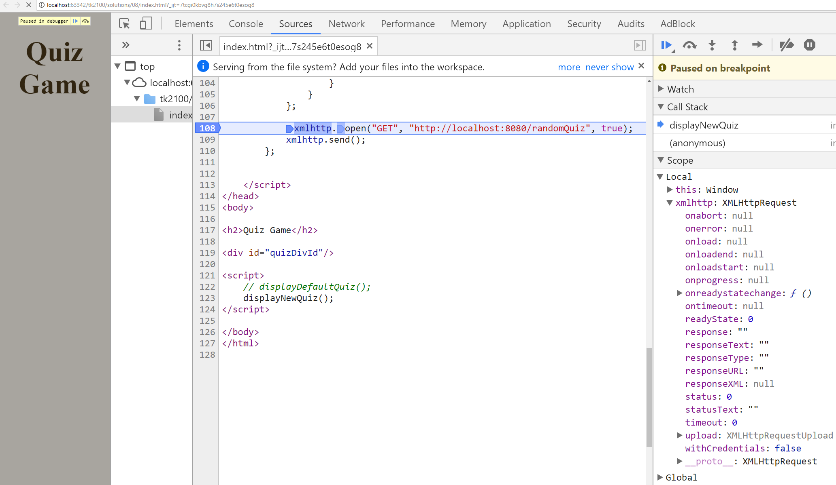
Use Break-Points to help debugging
Can pause, and execute 1 statement at a time
Inspect values of variables

Slide 86
For Next Week
Book pages: 328-333, 339-341
Note: when I tell you to study some specific pages in the book, it would be good if you also read the other pages in the same chapter at least once
Exercises for Lesson 8 on GitHub repository

